Slide 1

AUTO ENCODERS IN DEEP LEARNING
UNIT-3 INTRODUCTION
UNIT-5

Slide 2
UNIT-4 Content
Auto-encoders and unsupervised learning,
Stacked auto-encoders and semi-supervised learning,
Regularization - Dropout and Batch normalization.

Slide 3
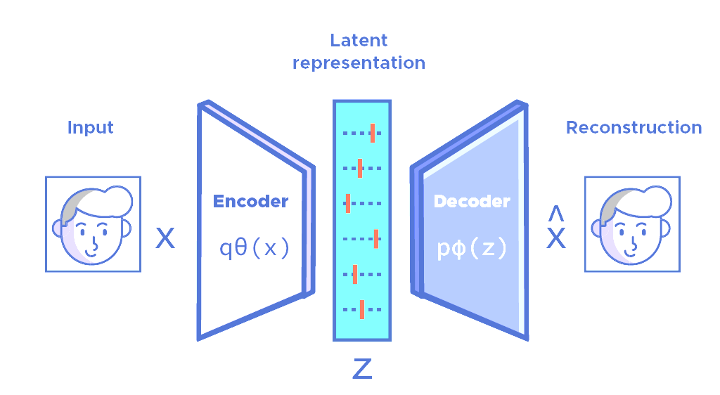
UNIT-5 Auto-encoders and unsupervised learning

Slide 4
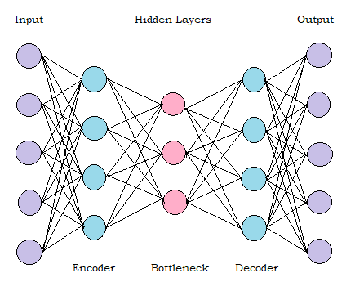
UNIT-5 Auto-encoders and unsupervised learning
Encoder: This is the part where the model learns how to reduce the number of features required to represent the data. This is the part which performs feature learning.
Bottleneck: This is the layer that has the minimum number of neurons in the model. It contains the compressed representation of input data with the lowest dimensionality possible.
Decoder: This part performs the reconstruction of the compressed representation of the input data from the bottleneck. The aim is to produce an output that is as close to the input as possible.
Reconstruction Loss: This is a mathematical function that computes the difference between the output and input, also called loss. It is a measure of the performance of the autoencoder.

Slide 5
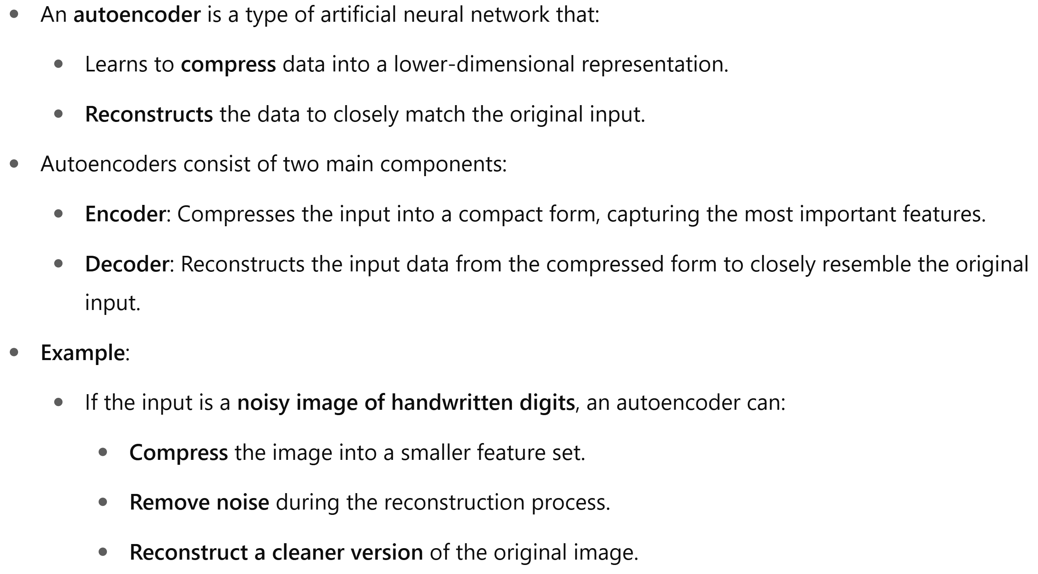
UNIT-5 Auto-encoders and unsupervised learning

Slide 6
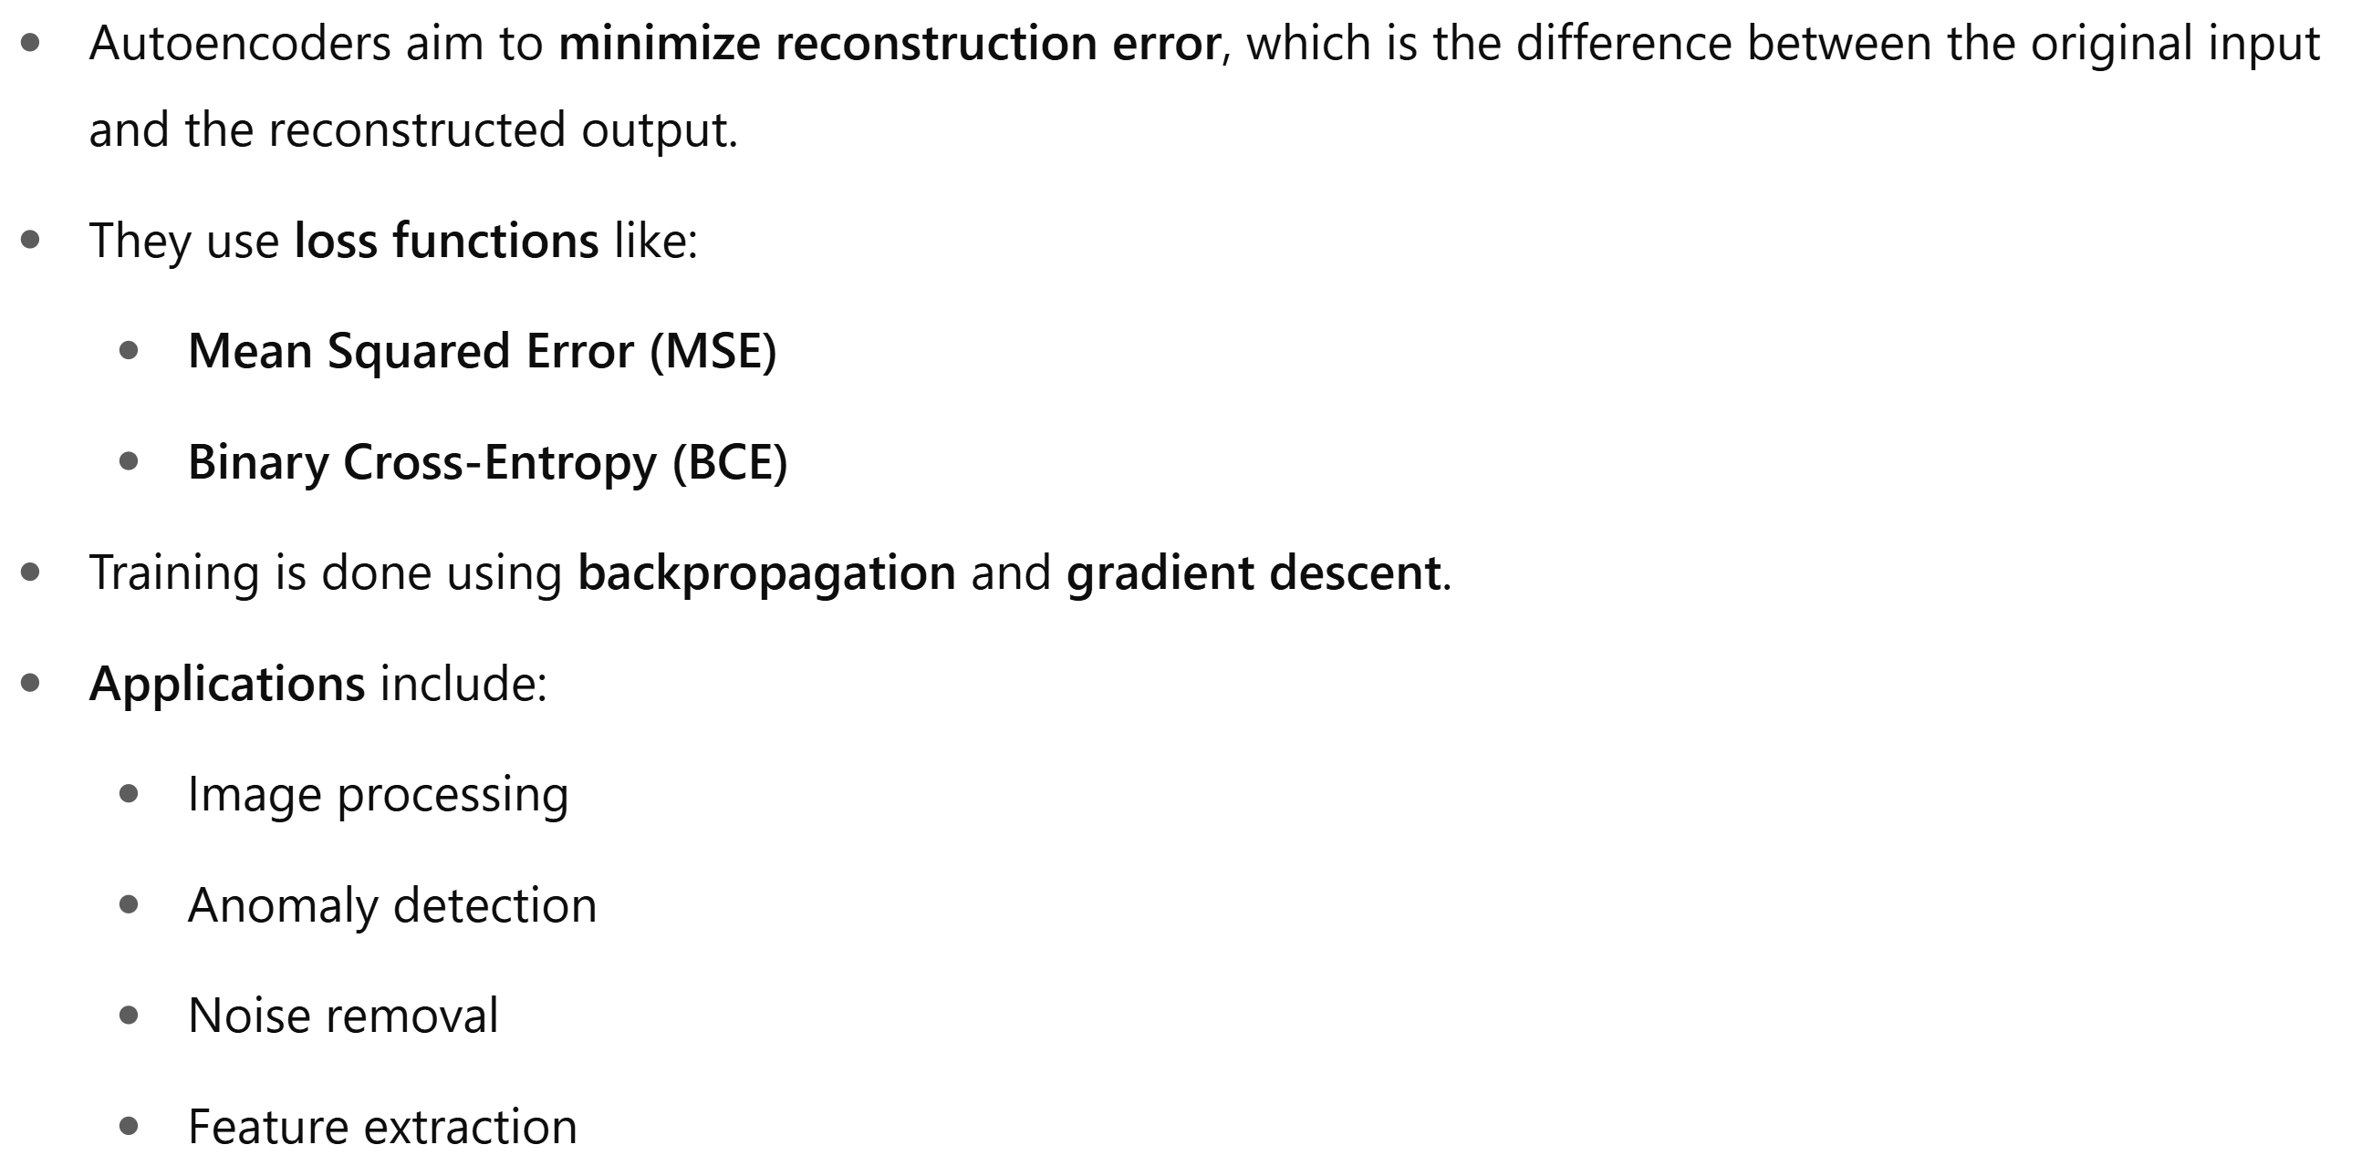
UNIT-5 Auto-encoders and unsupervised learning

Slide 7
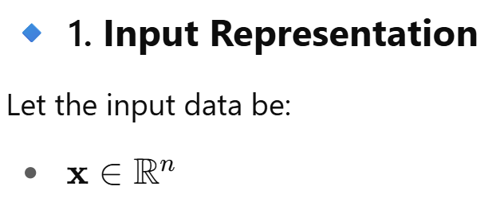
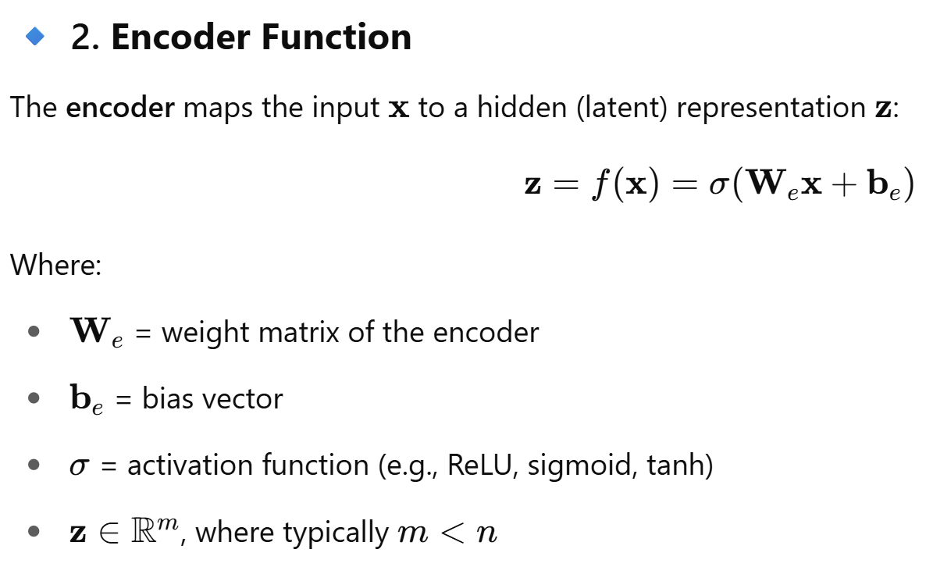
UNIT-5 Mathematics behind Auto encoder

Slide 8
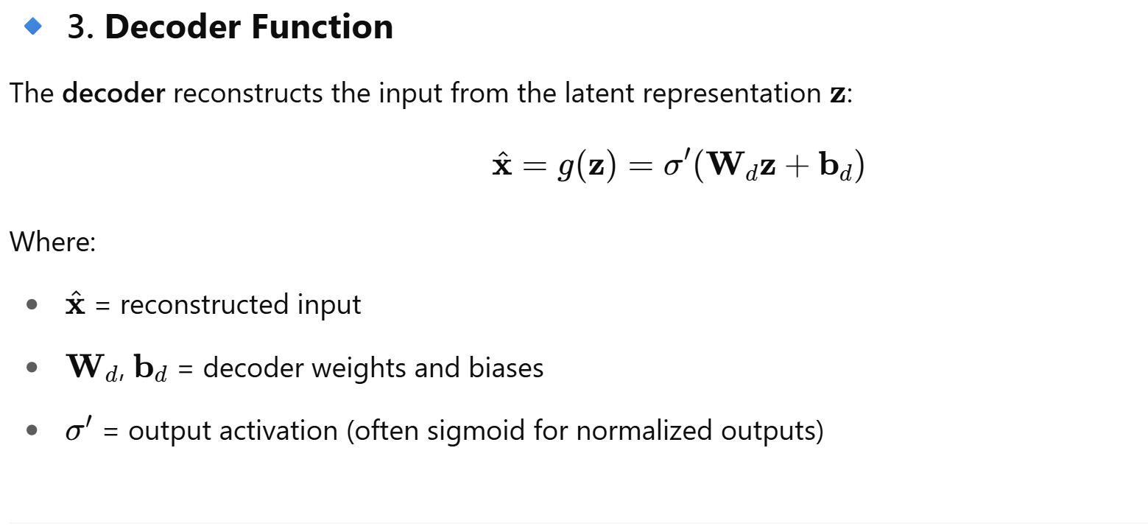
UNIT-5 Mathematics behind Auto encoder

Slide 9
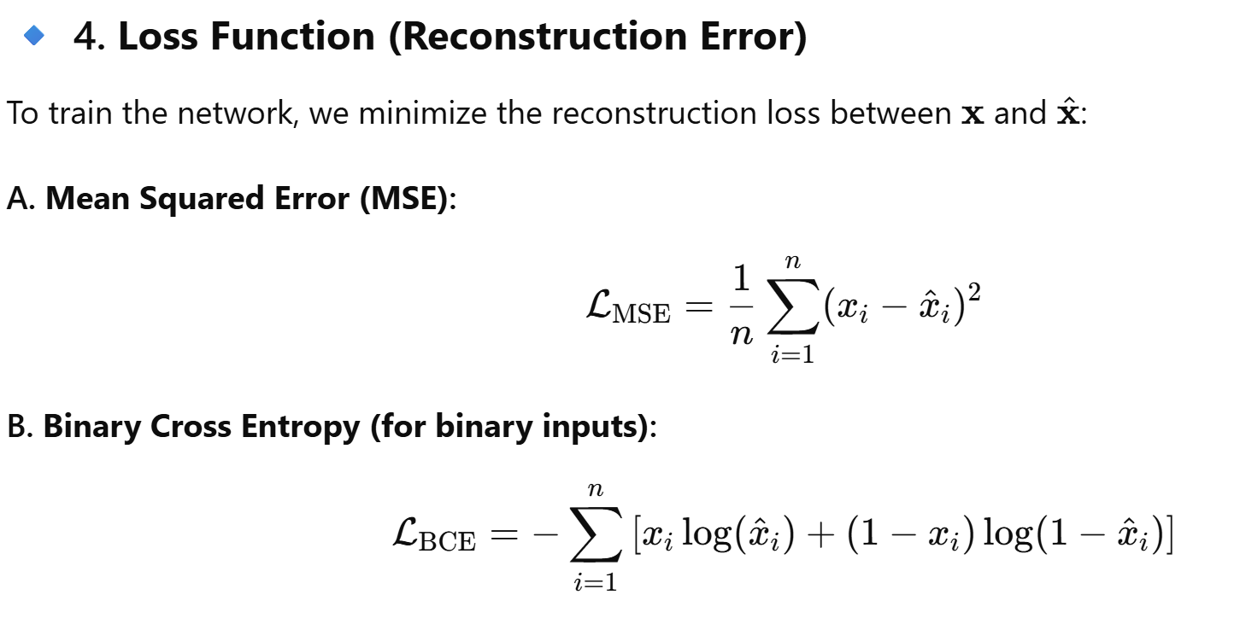
UNIT-5 Mathematics behind Auto encoder

Slide 10
UNIT-5 Mathematics behind Auto encoder

Slide 11
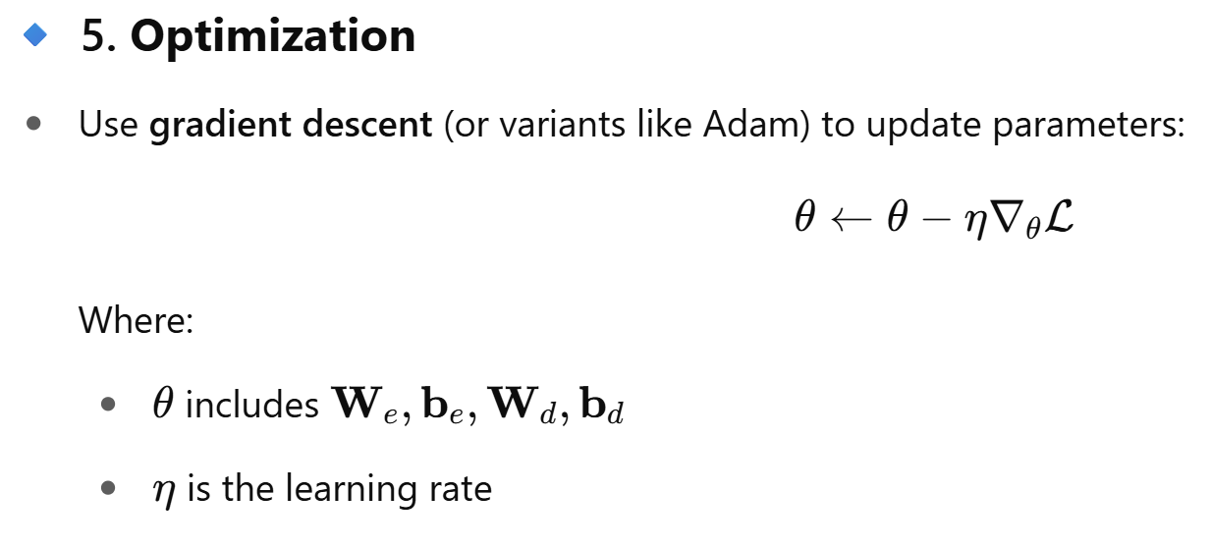
UNIT-5 Mathematics behind Auto encoder

Slide 12
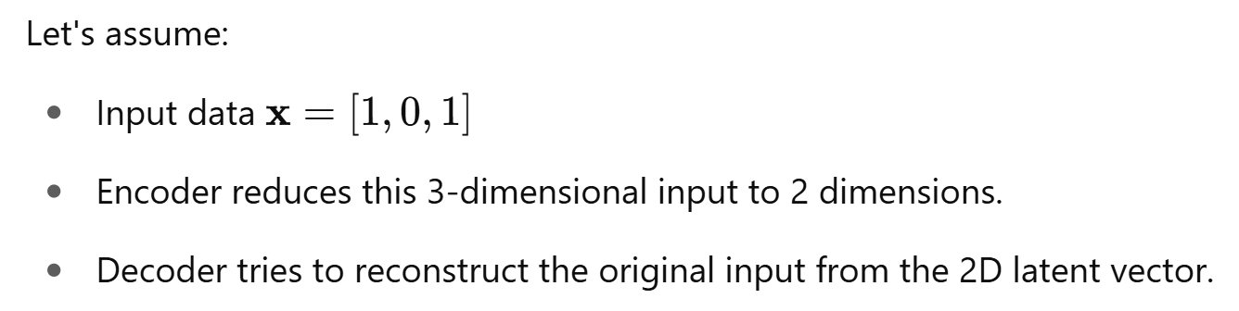
UNIT-5 Example of Auto encoder

Slide 13
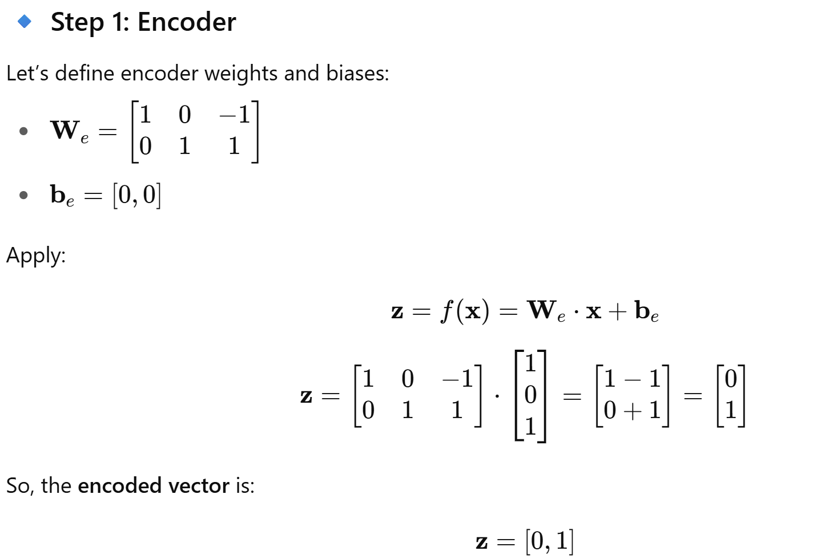
UNIT-5 Example of Auto encoder

Slide 14
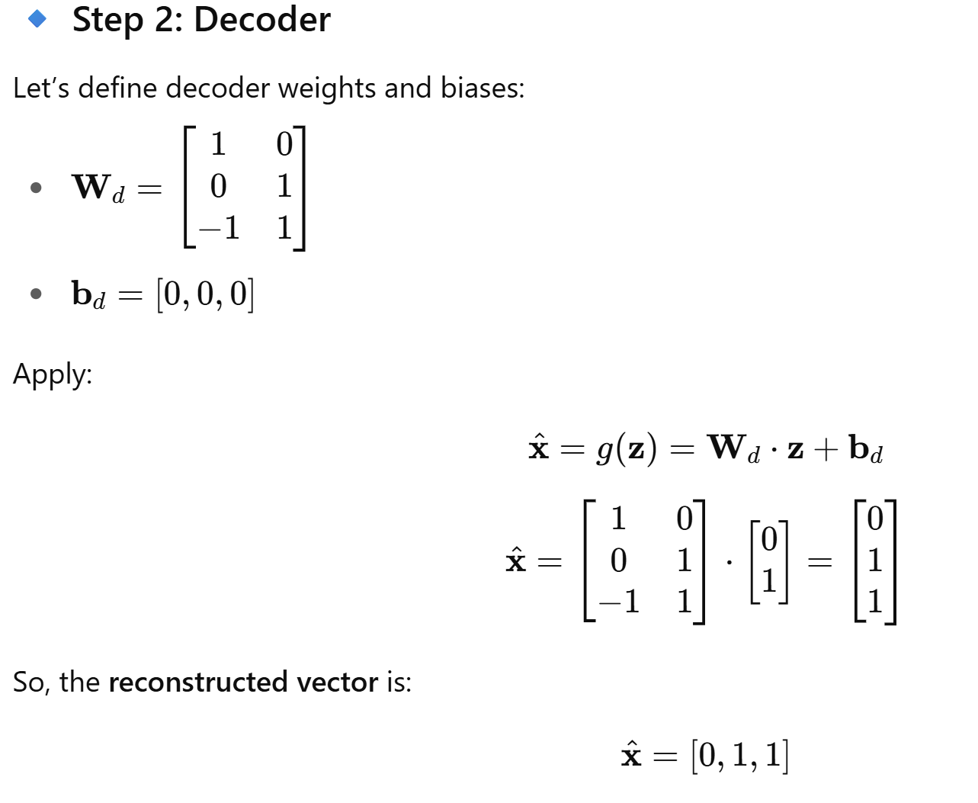
UNIT-5 Example of Auto encoder

Slide 15
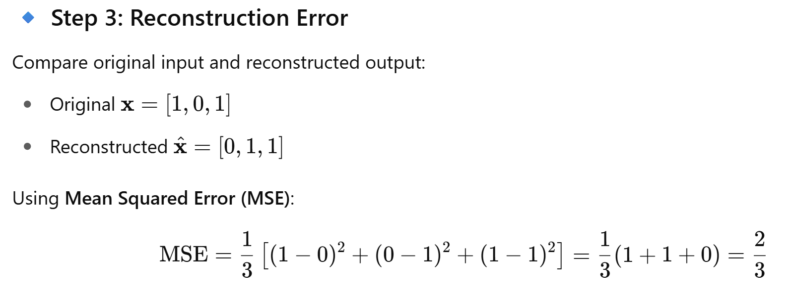
UNIT-5 Example of Auto encoder

Slide 16
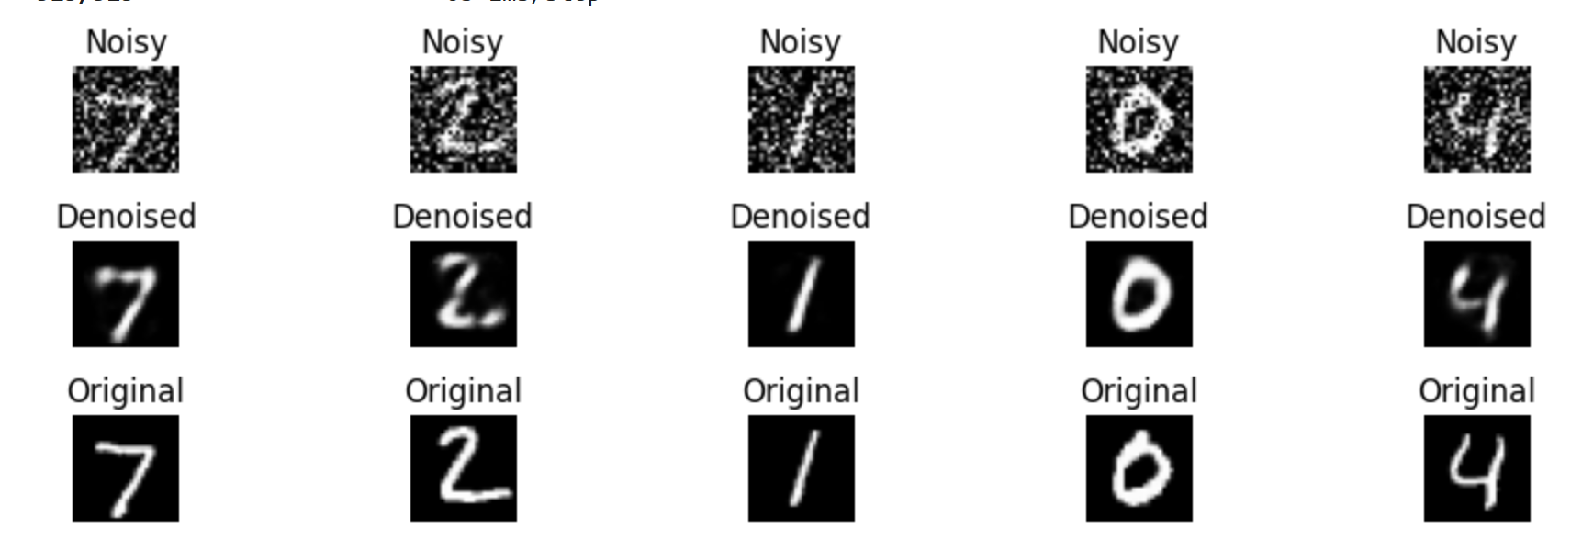
UNIT-5 Denoising a Noisy Handwritten Digit Image (MNIST)

Slide 17
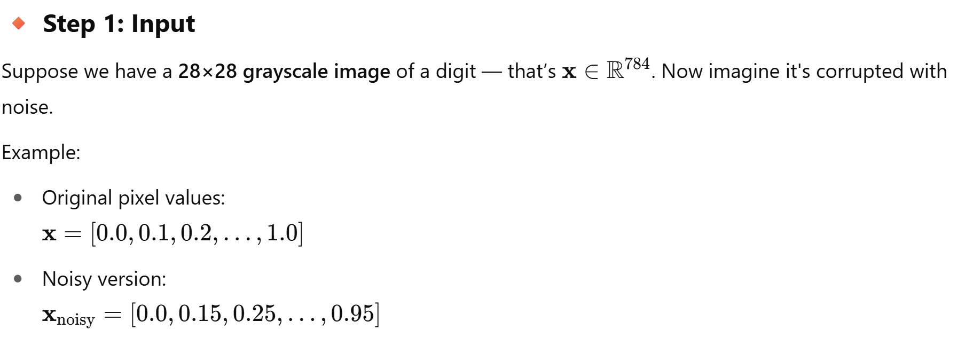
UNIT-5 Denoising a Noisy Handwritten Digit Image (MNIST)

Slide 18
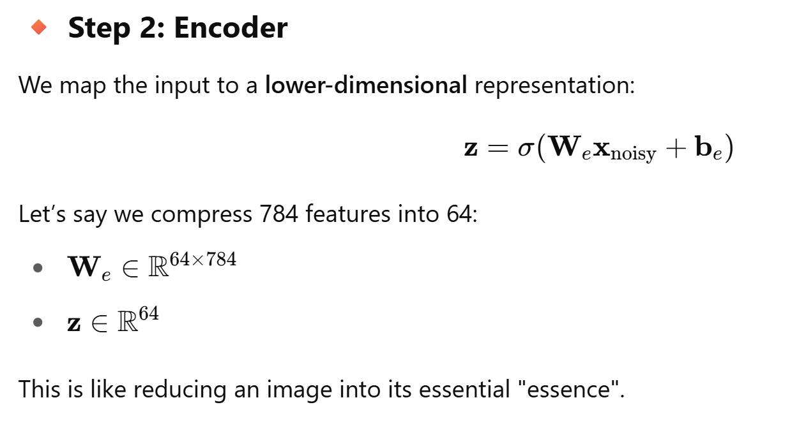
UNIT-5 Denoising a Noisy Handwritten Digit Image (MNIST)

Slide 19
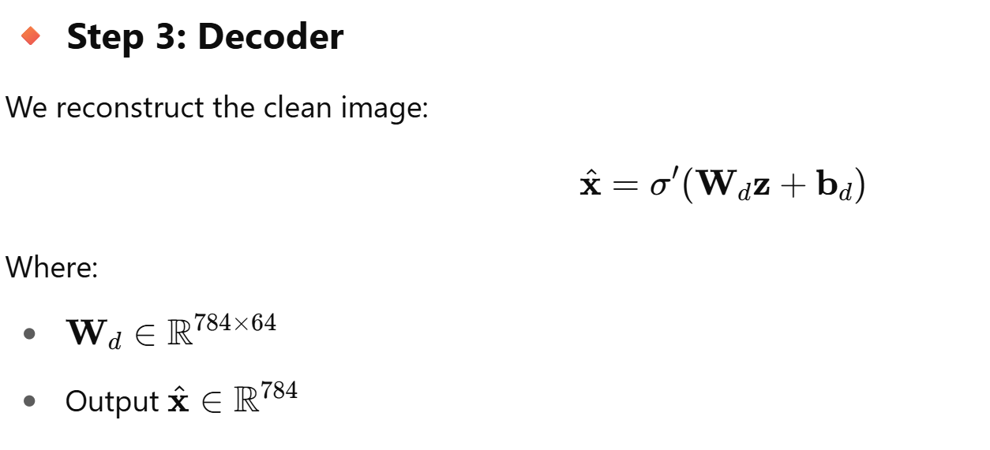
UNIT-5 Denoising a Noisy Handwritten Digit Image (MNIST)

Slide 20
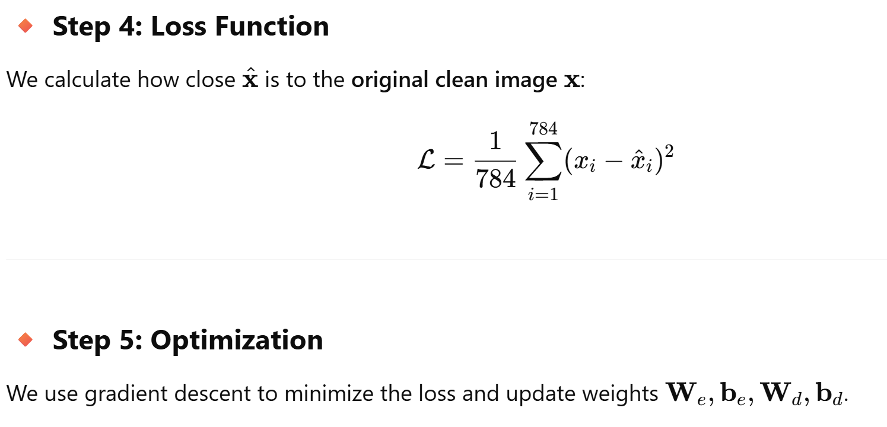
UNIT-5 Denoising a Noisy Handwritten Digit Image (MNIST)
https://colab.research.google.com/drive/1eFoSikGTYUVz_kQCtxSraCB5HUdWCcMg?authuser=1#scrollTo=6blYgVP6D2r3

Slide 21
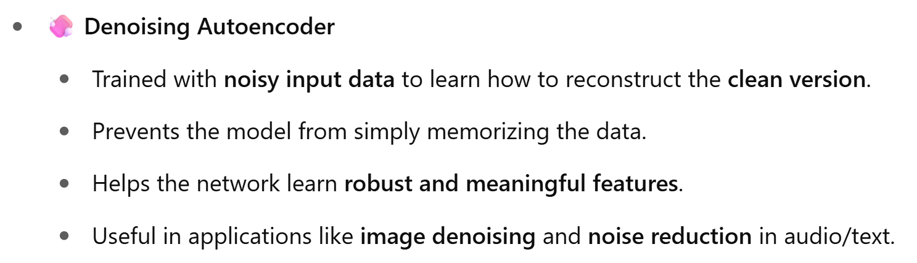
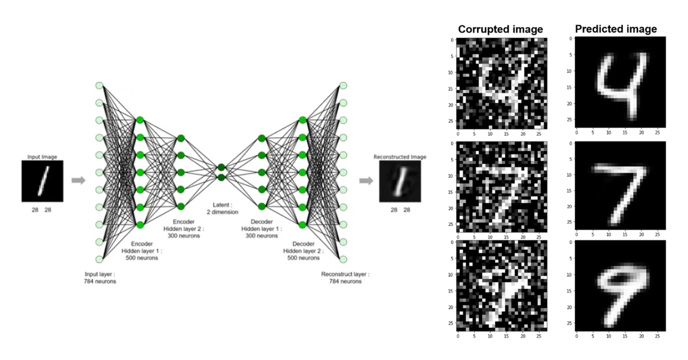
UNIT-5 Types of Autoencoders
https://www.geeksforgeeks.org/denoising-autoencoders-in-machine-learning/

Slide 22
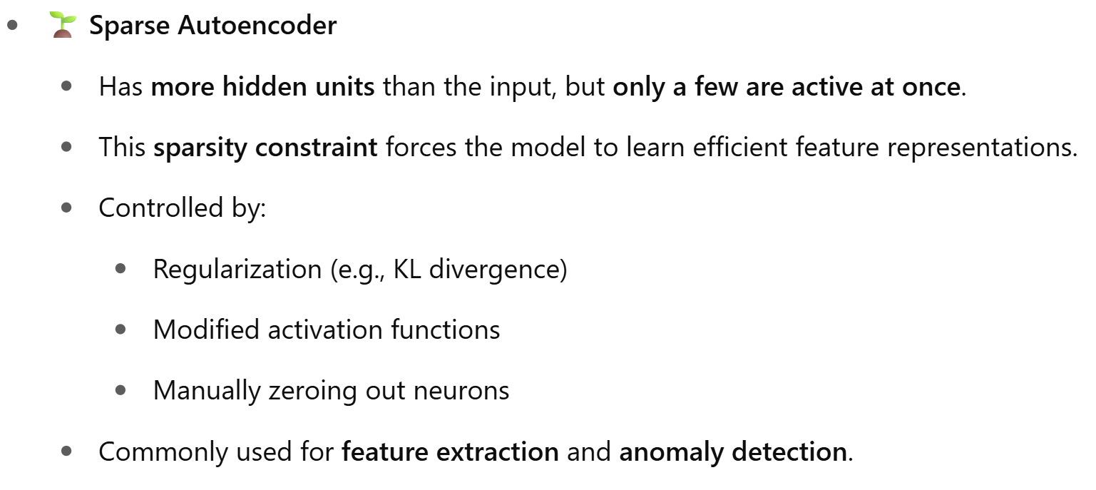
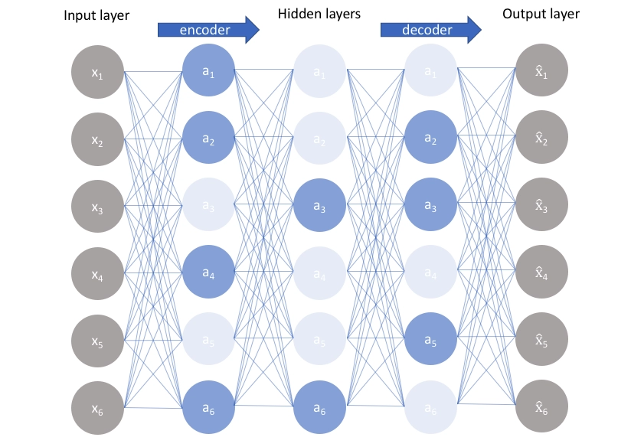
UNIT-5 Types of Autoencoders
https://www.geeksforgeeks.org/sparse-autoencoders-in-deep-learning/

Slide 23
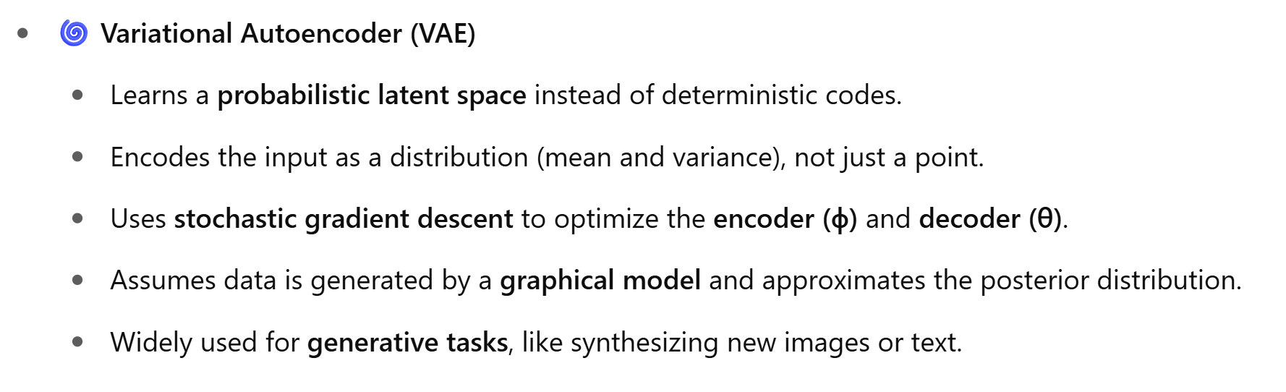
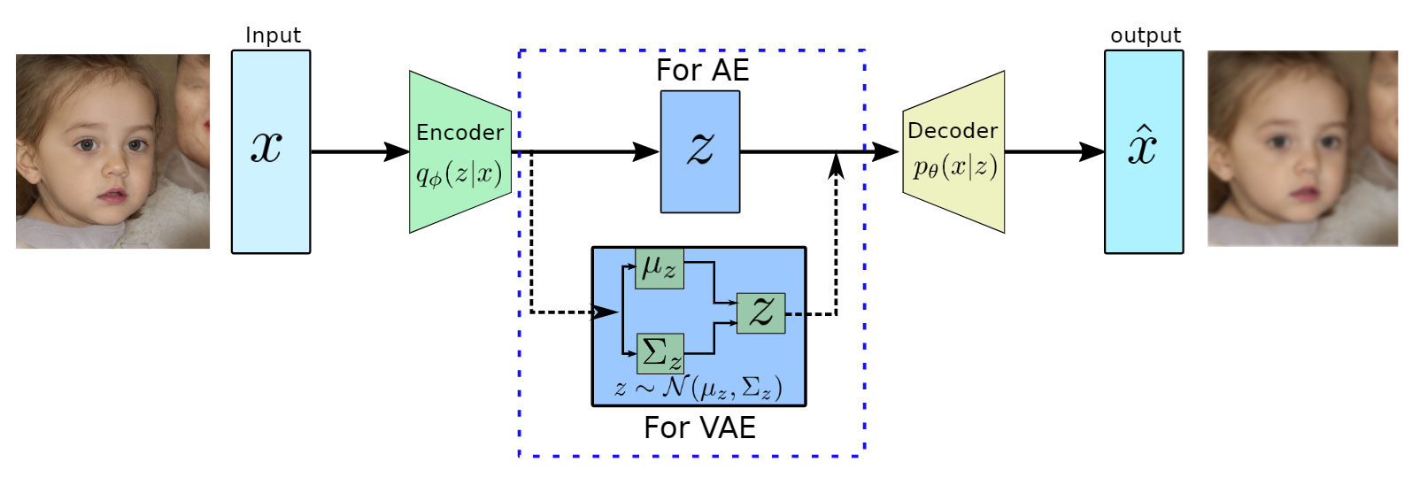
UNIT-5 Types of Autoencoders
https://www.geeksforgeeks.org/variational-autoencoders/

Slide 24
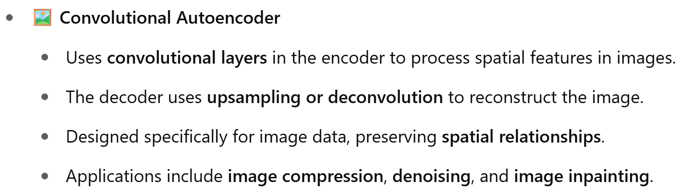
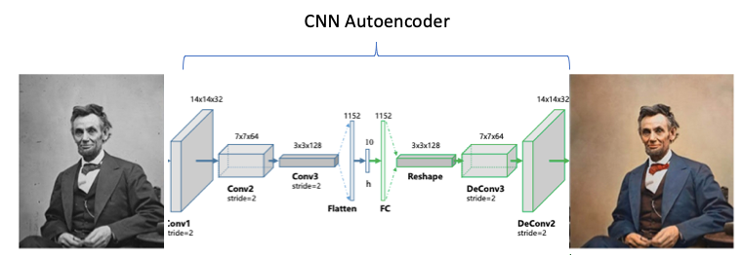
UNIT-5 Types of Autoencoders
https://www.geeksforgeeks.org/implement-convolutional-autoencoder-in-pytorch-with-cuda/

Slide 25
UNIT-5 Questions for Practice
1. What is an autoencoder, and what is its primary purpose in machine learning? (Knowledge)
2. How does an autoencoder learn to encode and decode data? Explain the process in simple terms. (Comprehension)
3. How would you use a denoising autoencoder to remove noise from images in a dataset? Provide a brief explanation of the process. (Application)
4. Compare the encoder and decoder components of an autoencoder. How do these components differ in their roles during training? (Analysis)
5. Given two types of autoencoders—Variational Autoencoder (VAE) and Convolutional Autoencoder (CAE)—which one would you choose for generating new images and why? (Evaluation)
6. Design a simple autoencoder architecture to handle a dataset of 100x100 color images. What layers and activation functions would you choose to ensure effective learning and reconstruction? (Synthesis)
7. What is the difference between a sparse autoencoder and a regular autoencoder? (Knowledge)
8. Explain why using a bottleneck layer in the architecture of an autoencoder is crucial for learning a compressed representation of the input data. (Comprehension)
9. How can an autoencoder be used for anomaly detection? Provide a scenario where this technique might be applied. (Application)
10. You are tasked with improving an autoencoder model that is underfitting. What changes would you suggest in terms of network architecture, training data, or other factors? (Evaluation)

Slide 26
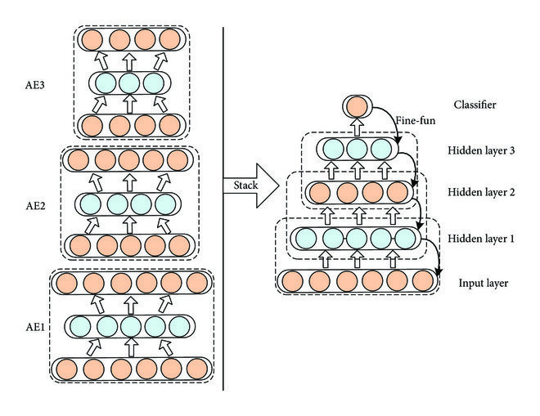
UNIT-5 Stacked auto-encoders
A Stacked Autoencoder is a deep learning architecture composed of multiple layers of autoencoders stacked on top of each other.
It's used for unsupervised feature learning, dimensionality reduction, and pretraining deep networks.
A Stacked Autoencoder (SAE) is formed by stacking multiple autoencoders, where the output of one encoder becomes the input of the next.
Each layer is trained to learn increasingly abstract representations of the input data.

Slide 27
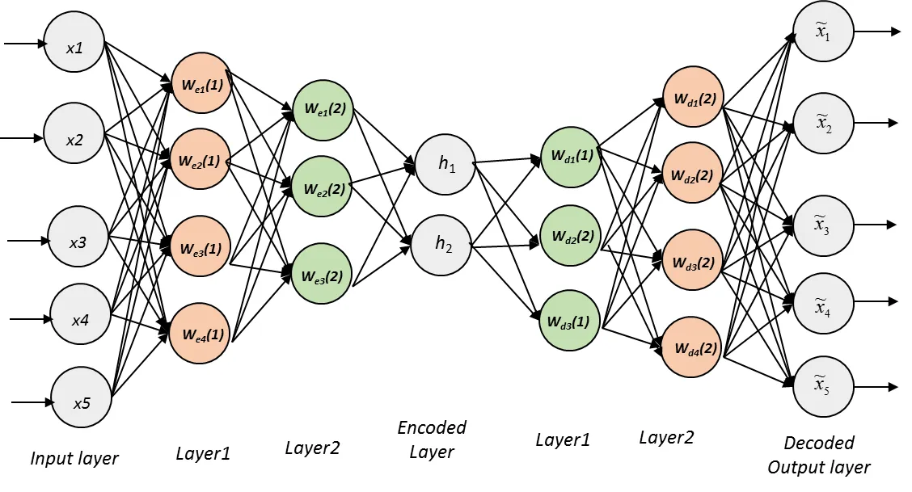
UNIT-5 Stacked auto-encoders

Slide 28
UNIT-5 Stacked auto-encoders
A stacked autoencoder is a neural network consist several layers of sparse autoencoders where output of each hidden layer is connected to the input of the successive hidden layer.
As shown in Figure below the hidden layers are trained by an unsupervised algorithm and then fine-tuned by a supervised method.
Stacked autoencoder mainly consists of three steps
Train autoencoder using input data and acquire the learned data.
The learned data from the previous layer is used as an input for the next layer and this continues until the training is completed.
Once all the hidden layers are trained use the backpropagation algorithm to minimize the cost function and weights are updated with the training set to achieve fine tuning.

Slide 29
UNIT-5 Architecture Stacked auto-encoders
Input Layer
Output Layer
Encoder-1
Encoder-2
Encoder-n
Decoder-1
Decoder-1
Decoder-n
Components:
Input Layer
Multiple Hidden (Encoder) Layers
Latent Representation Layer
Multiple Hidden (Decoder) Layers
Reconstruction Layer (Output)
Bottle neck
Layer | Size (Example) | Description
Input Layer | 784 | Original input vector (flattened image)
Encoder Layer 1 | 512 | First compressed representation
Encoder Layer 2 | 256 | Deeper compressed representation
Encoder Layer 3 | 64 | Final latent representation
Decoder Layer 1 | 256 | Begins reconstruction
Decoder Layer 2 | 512 | Further reconstruction
Output Layer | 784 | Reconstructed input
Layer-Wise Breakdown
Let’s assume input size = 784 (e.g., a 28×28 pixel image from MNIST):

Slide 30
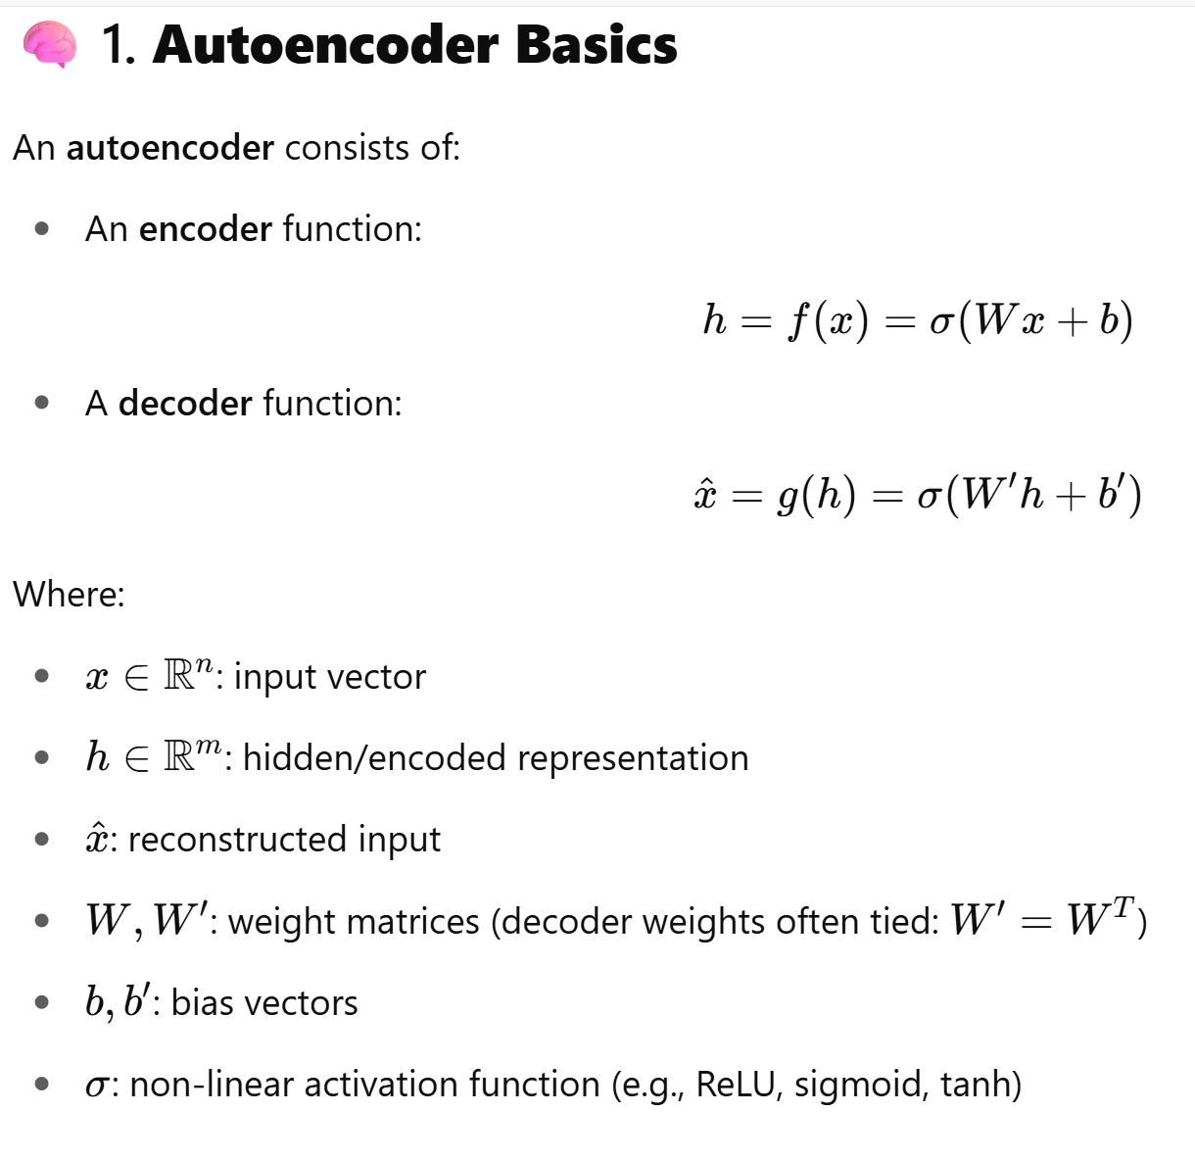
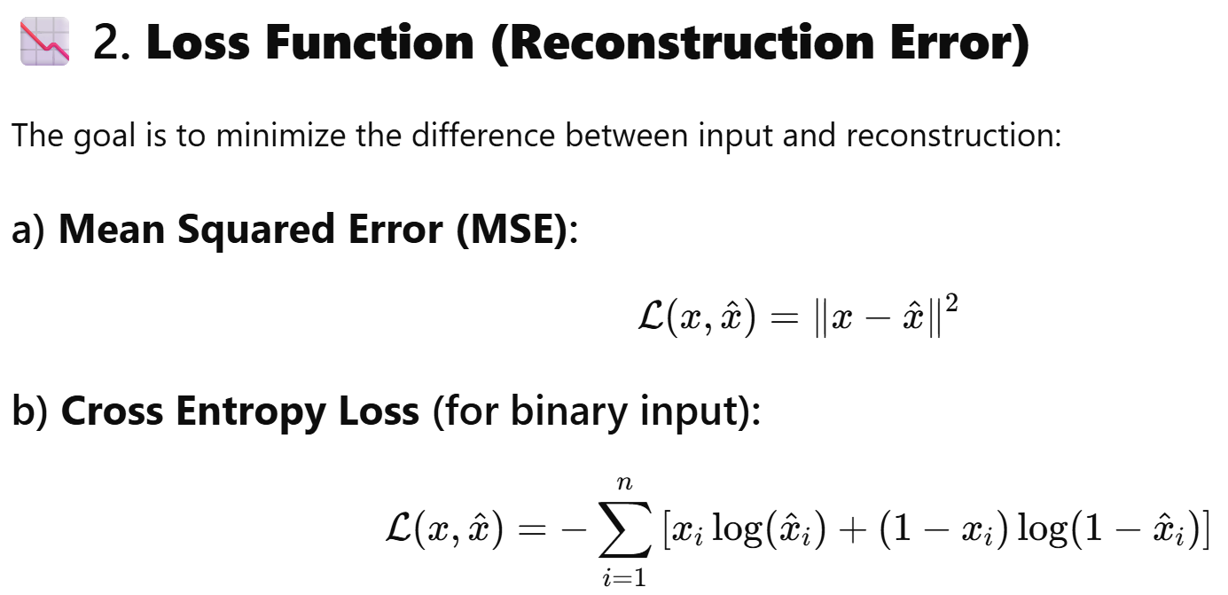
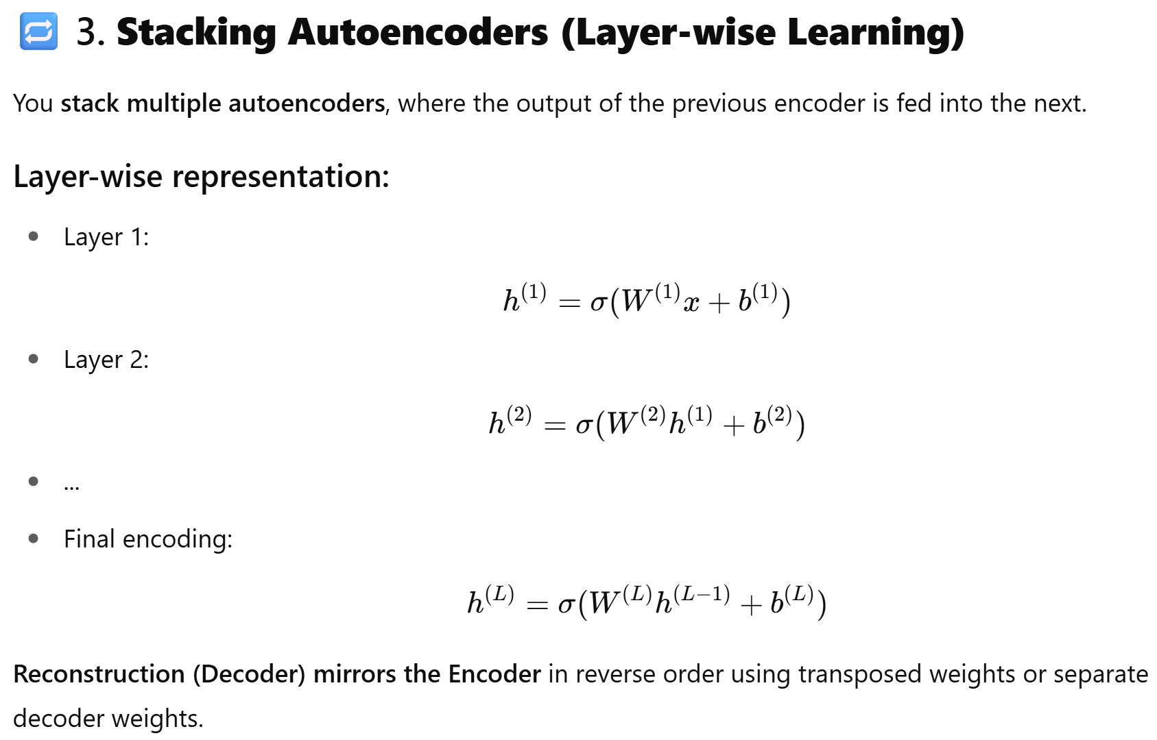
UNIT-5 Architecture Stacked auto-encoders

Slide 31
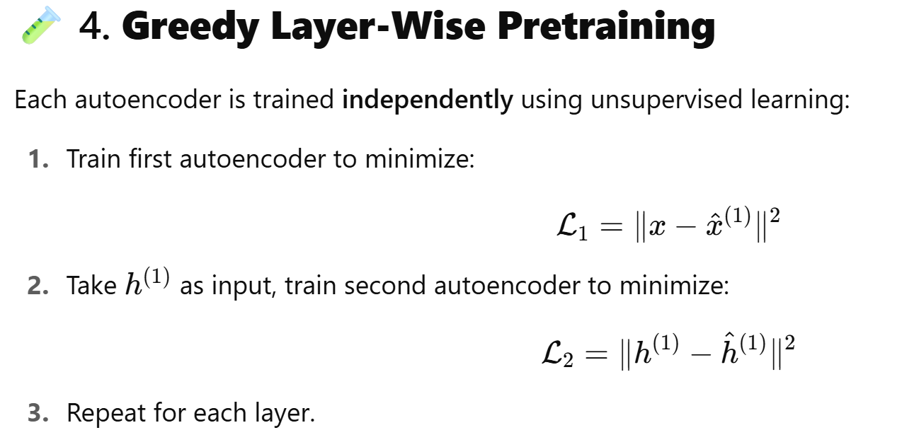
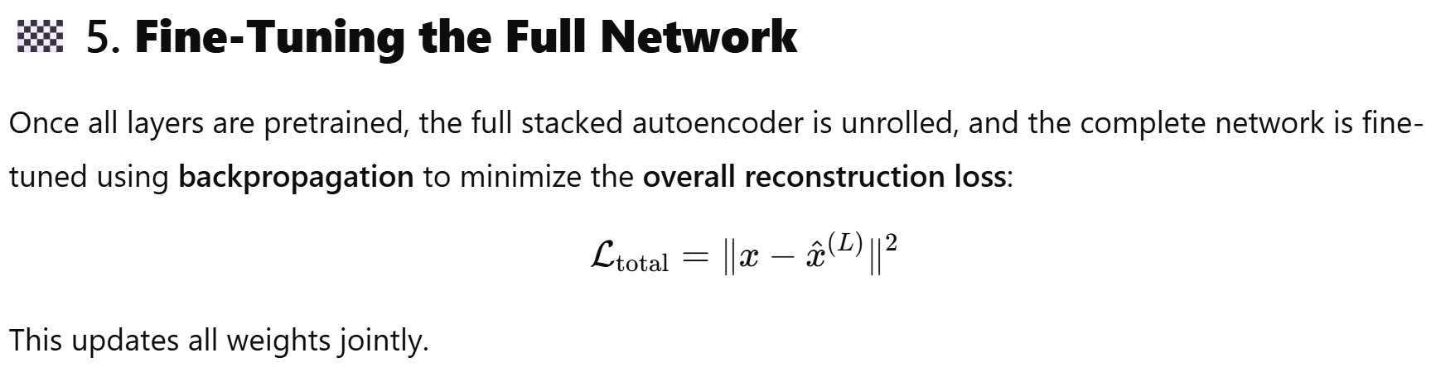
UNIT-5 Architecture Stacked auto-encoders

Slide 32
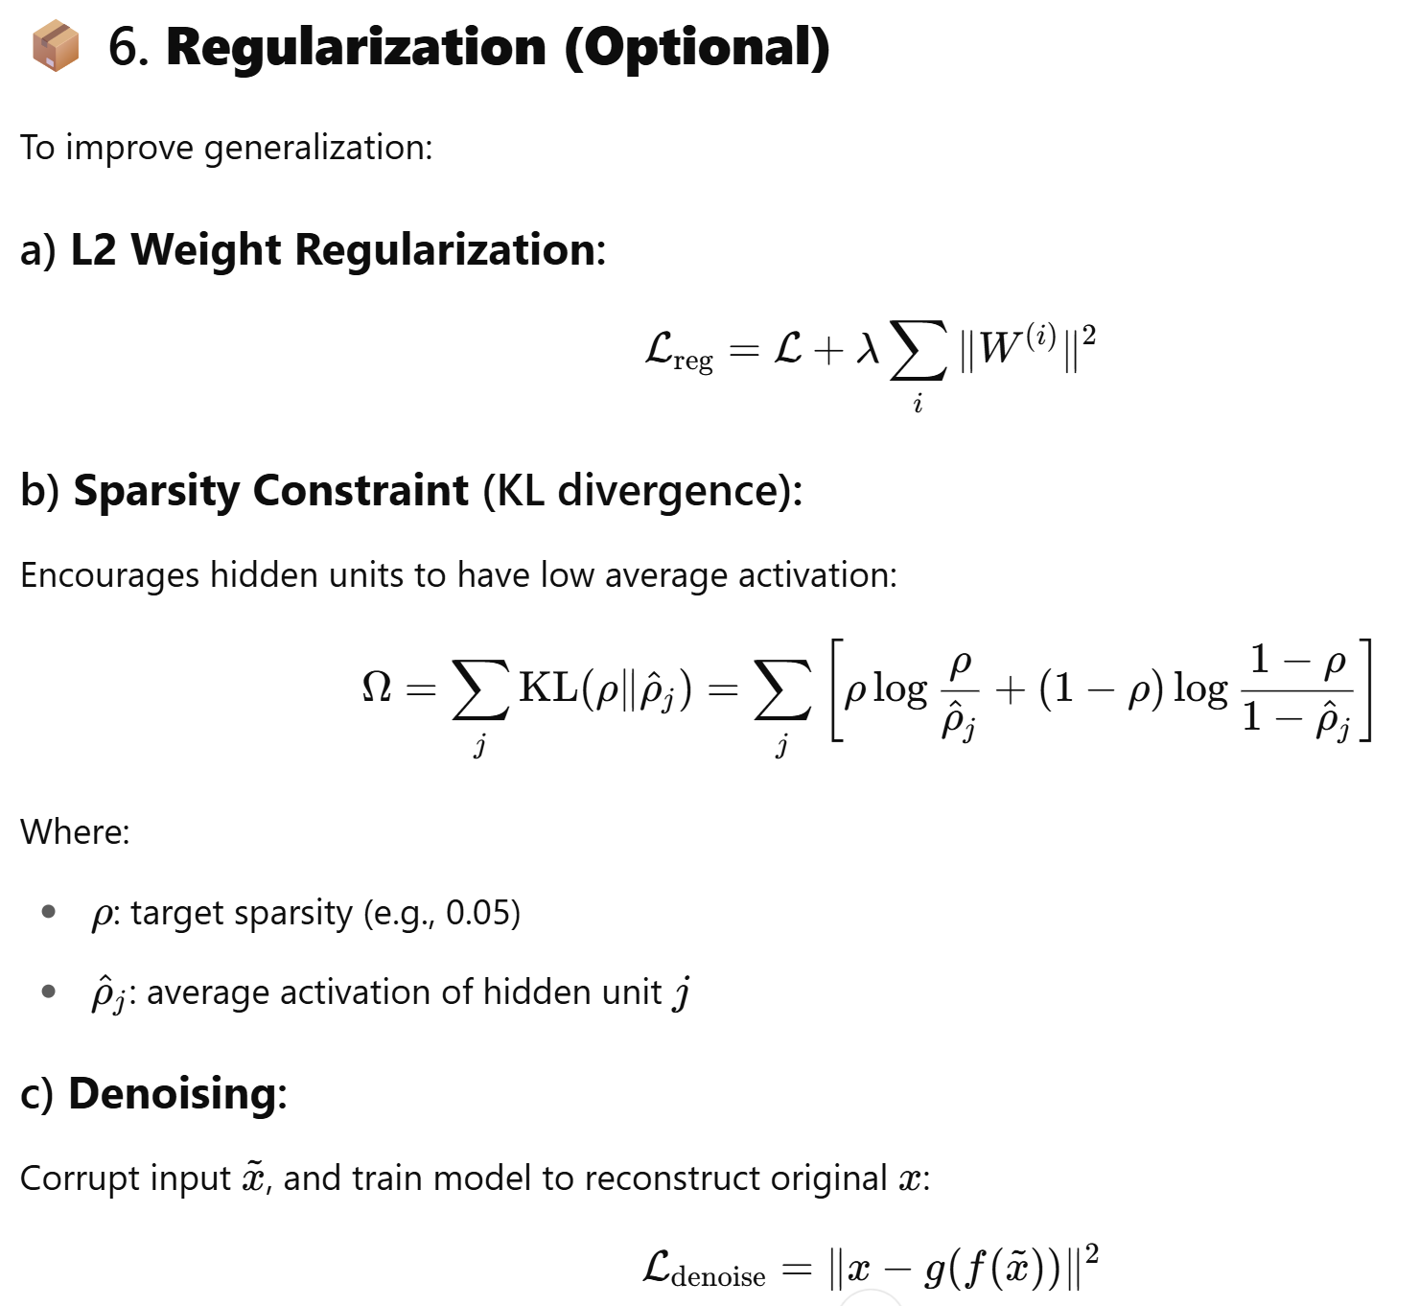
UNIT-5 Architecture Stacked auto-encoders

Slide 33
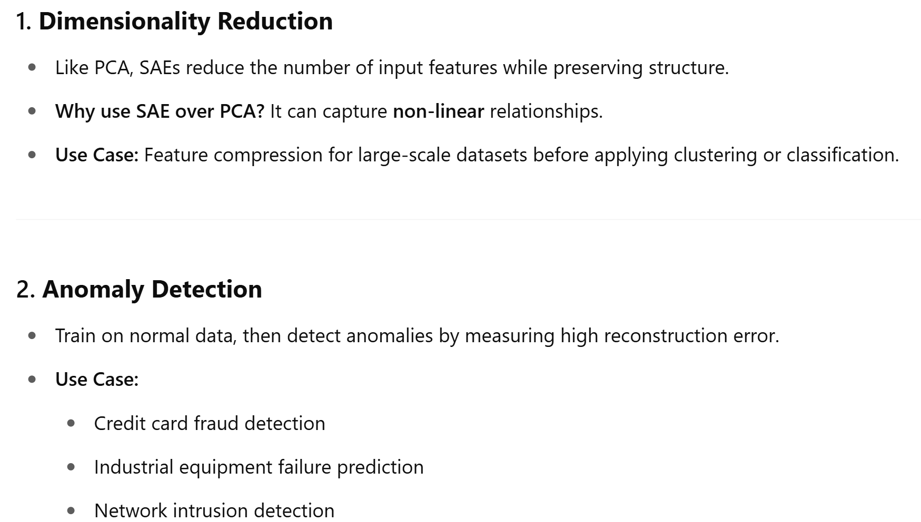
UNIT-5 Key Applications of Stacked Autoencoders

Slide 34
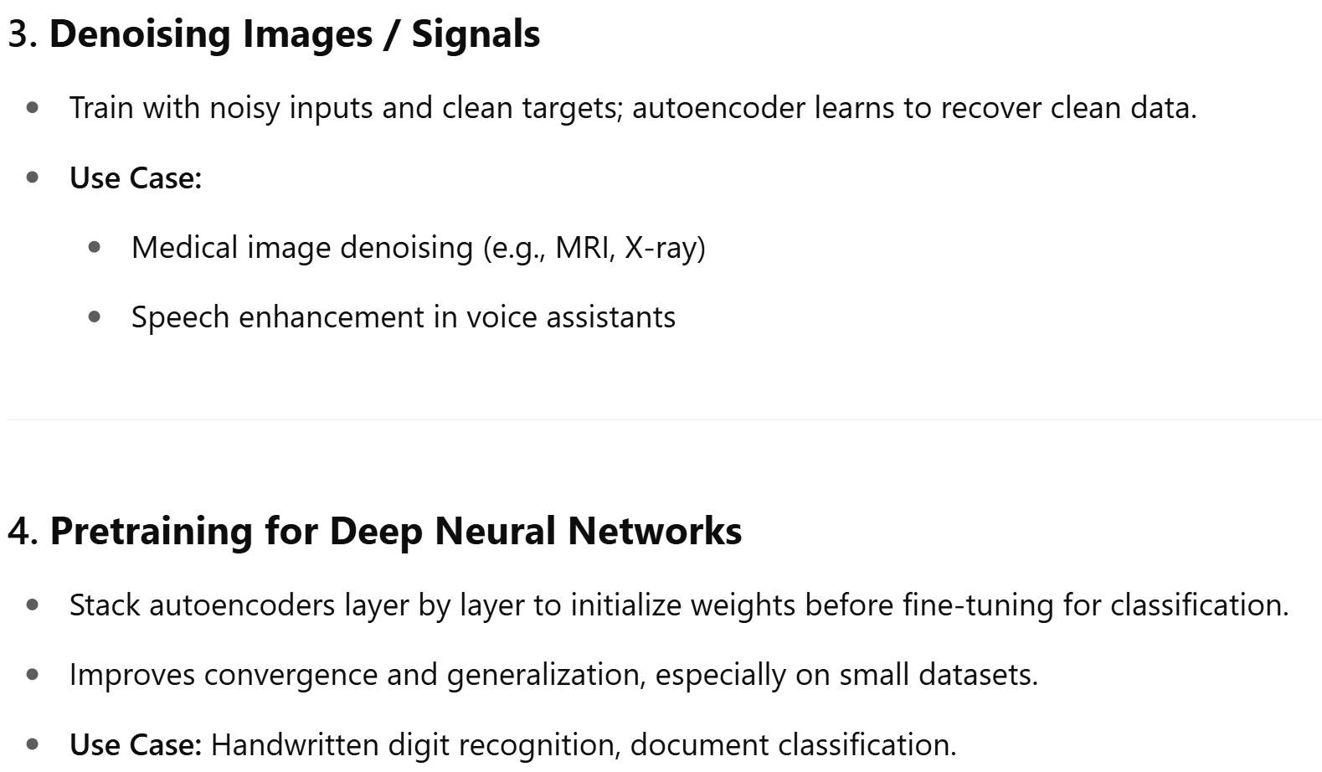
UNIT-5 Key Applications of Stacked Autoencoders

Slide 35
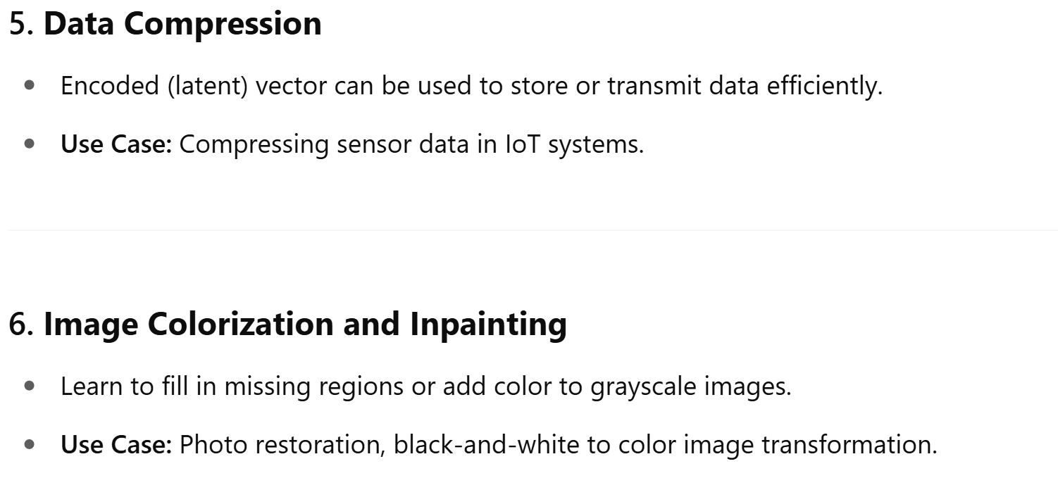
UNIT-5 Key Applications of Stacked Autoencoders

Slide 36
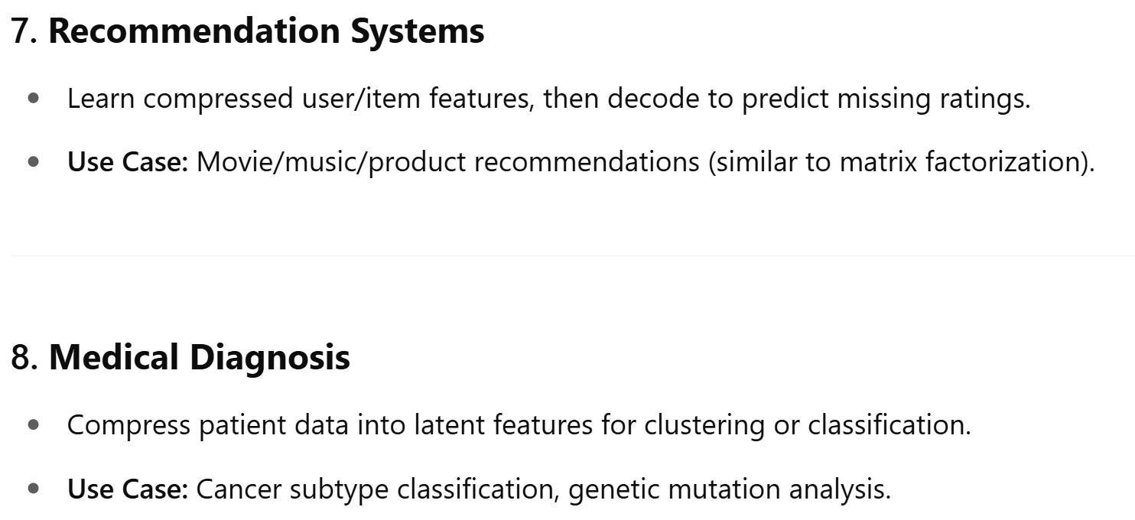
UNIT-5 Key Applications of Stacked Autoencoders

Slide 37
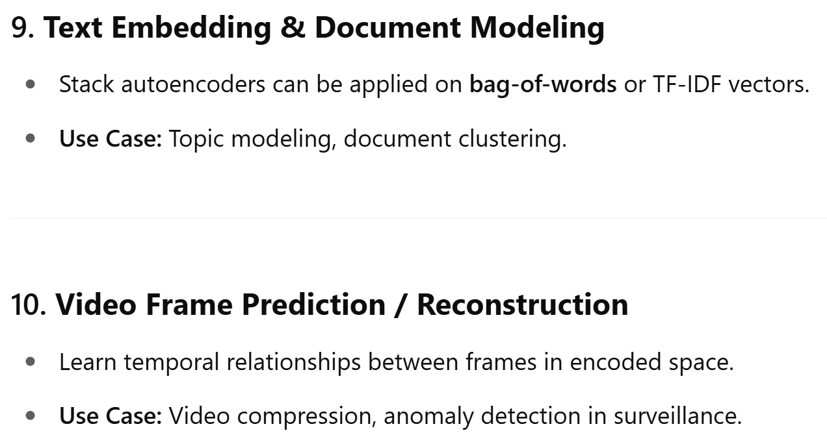
UNIT-5 Key Applications of Stacked Autoencoders

Slide 38
UNIT-5 Lab implementation
https://colab.research.google.com/drive/1eFoSikGTYUVz_kQCtxSraCB5HUdWCcMg?authuser=1#scrollTo=u1RSf5zMQFOA

Slide 39
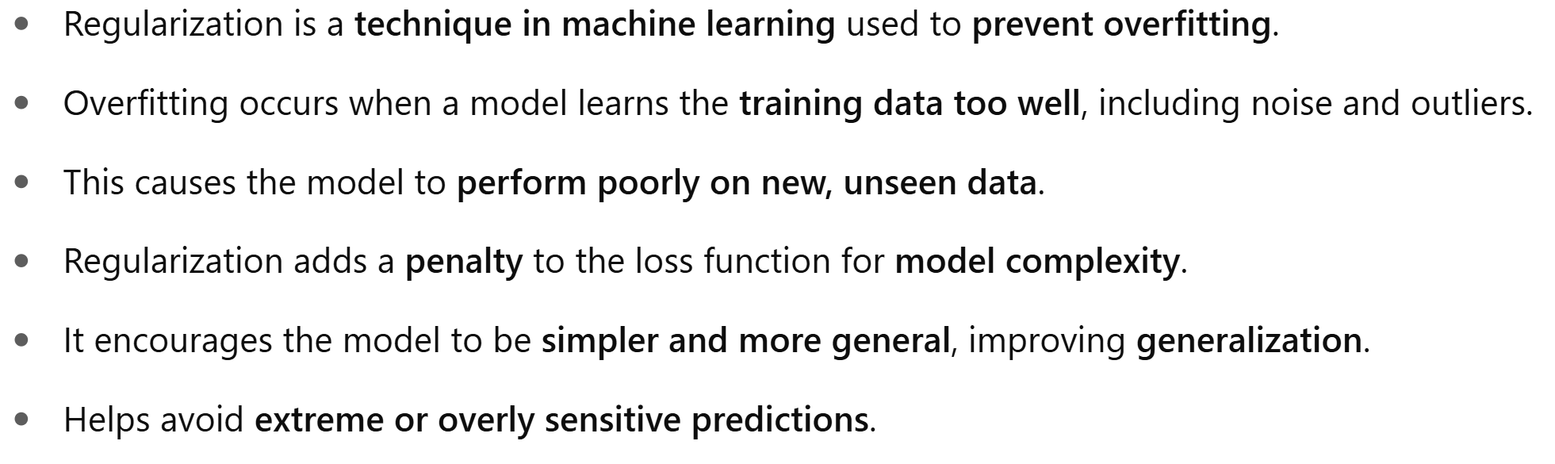
UNIT-5 Regularization

Slide 40
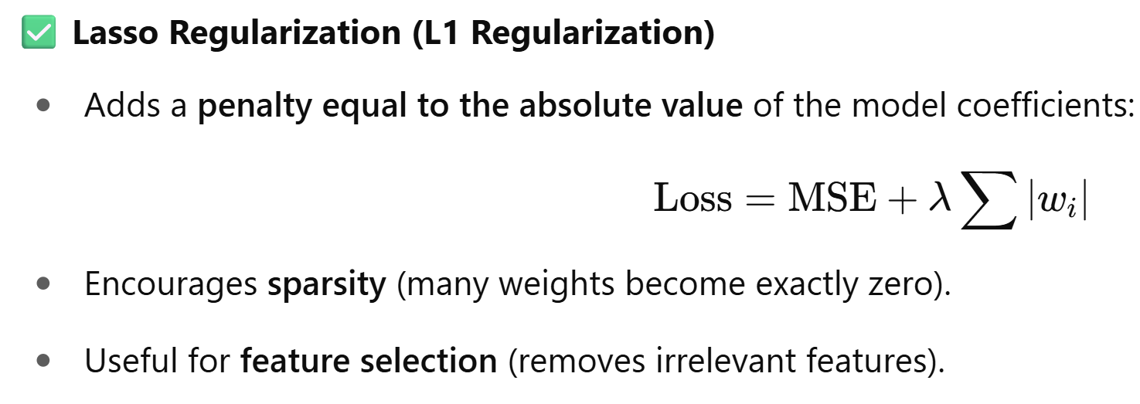
UNIT-5 Regularization Techniques

Slide 41
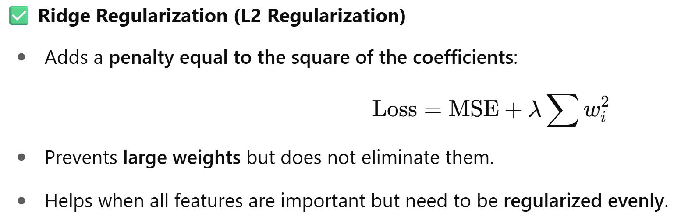
UNIT-5 Regularization Techniques

Slide 42
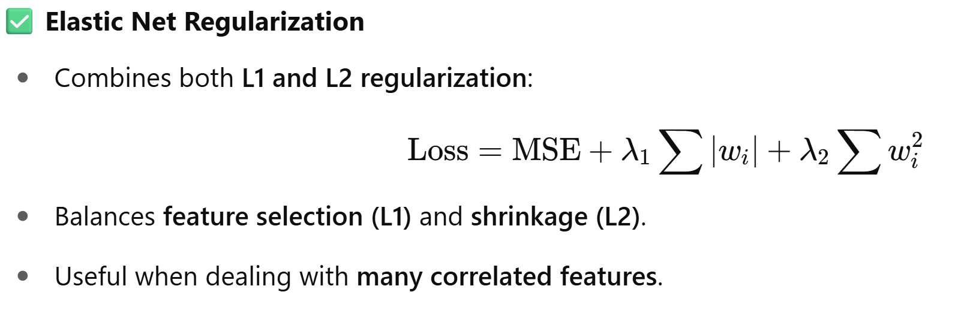
UNIT-5 Regularization Techniques

Slide 43
UNIT-5 Benefits of Regularization
Prevents Overfitting: Regularization helps models focus on underlying patterns instead of memorizing noise in the training data.
Improves Interpretability: L₁ (Lasso) regularization simplifies models by reducing less important feature coefficients to zero.
Enhances Performance: Prevents excessive weighting of outliers or irrelevant features, improving overall model accuracy.
Stabilizes Models: Reduces sensitivity to minor data changes, ensuring consistency across different data subsets.
Prevents Complexity: Keeps models from becoming too complex, which is crucial for limited or noisy data.
Handles Multicollinearity: Reduces the magnitudes of correlated coefficients, improving model stability.
Allows Fine-Tuning: Hyperparameters like alpha and lambda control regularization strength, balancing bias and variance.
Promotes Consistency: Ensures reliable performance across different datasets, reducing the risk of large performance shifts.

Slide 44
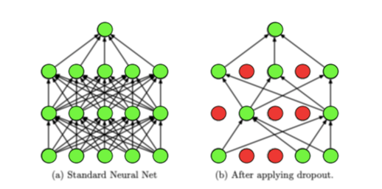
UNIT-5 Dropout

Slide 45
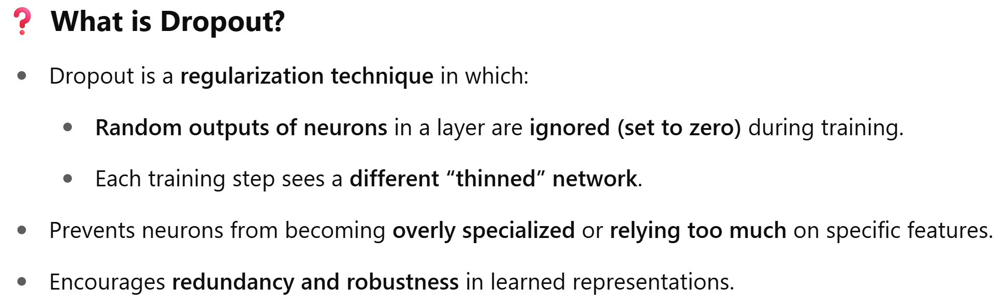
UNIT-5 Dropout

Slide 46
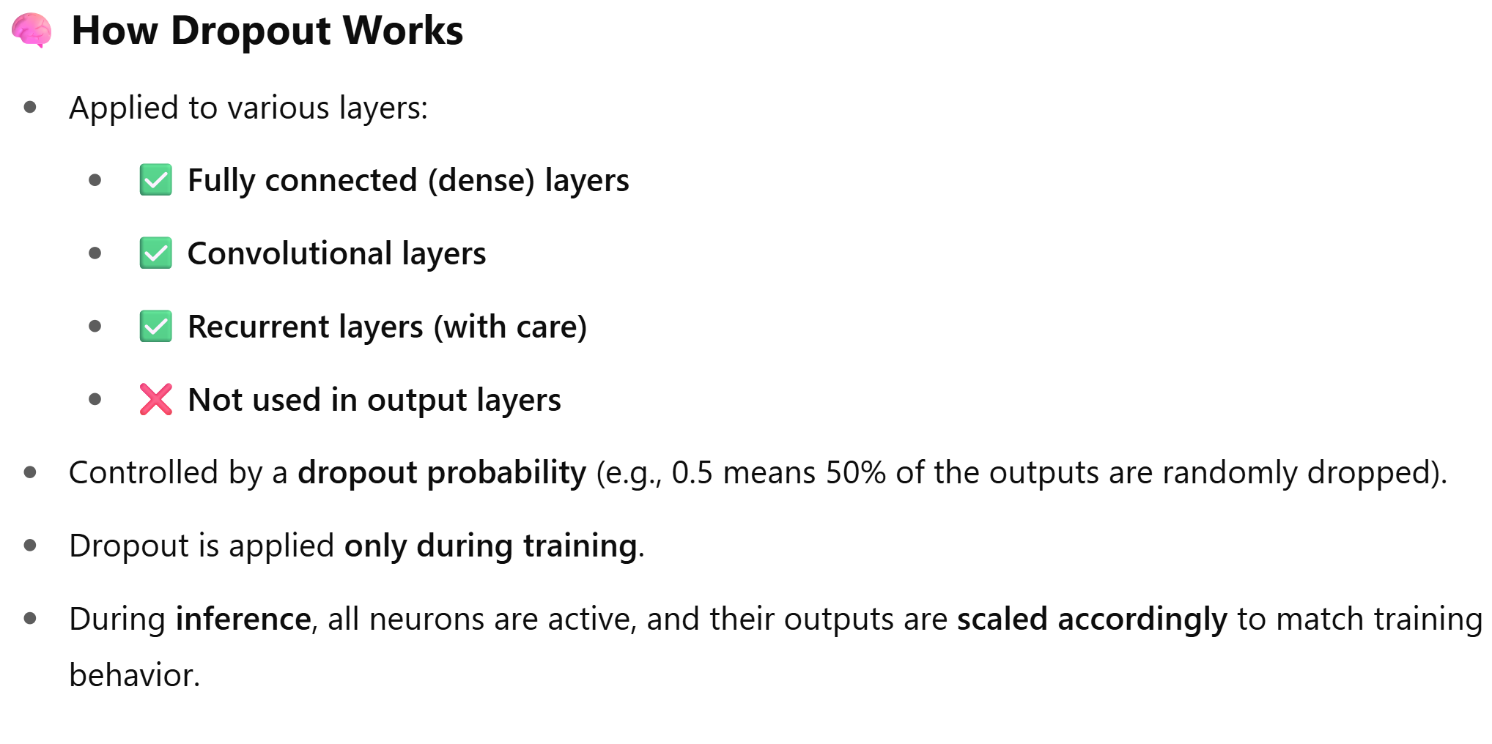
UNIT-5 Dropout

Slide 47
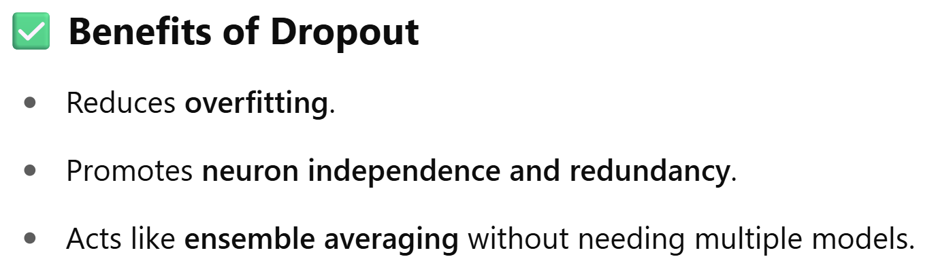
UNIT-5 Dropout

Slide 48
UNIT-5 Dropout
Advantages of Dropout Regularization in Deep Learning
Prevents Overfitting: By randomly disabling neurons, the network cannot overly rely on the specific connections between them.
Ensemble Effect: Dropout acts like training an ensemble of smaller neural networks with varying structures during each iteration. This ensemble effect improves the model's ability to generalize to unseen data.
Enhancing Data Representation: Dropout methods are used to enhance data representation by introducing noise, generating additional training samples, and improving the effectiveness of the model during training.

Slide 49
UNIT-5 Dropout
Drawbacks of Dropout Regularization and How to Mitigate Them
Despite its benefits, dropout regularization in deep learning is not without its drawbacks. Here are some of the challenges related to dropout and methods to mitigate them:
Longer Training Times: Dropout increases training duration due to random dropout of units in hidden layers. To address this, consider powerful computing resources or parallelize training where possible.
Optimization Complexity: Understanding why dropout works is unclear, making optimization challenging. Experiment with dropout rates on a smaller scale before full implementation to fine-tune model performance.
Hyperparameter Tuning: Dropout adds hyperparameters like dropout chance and learning rate, requiring careful tuning. Use techniques such as grid search or random search to systematically find optimal combinations.
Redundancy with Batch Normalization: Batch normalization can sometimes replace dropout effects. Evaluate model performance with and without dropout when using batch normalization to determine its necessity.
Model Complexity: Dropout layers add complexity. Simplify the model architecture where possible, ensuring each dropout layer is justified by performance gains in validation.

Slide 50
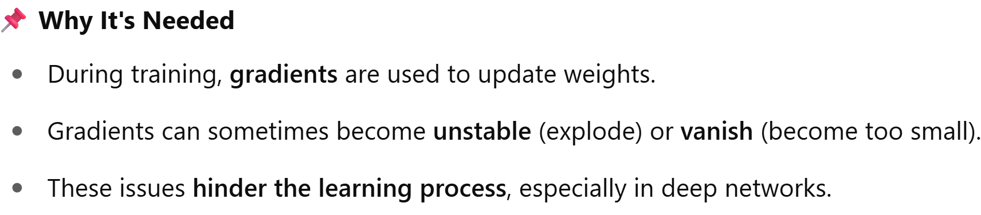
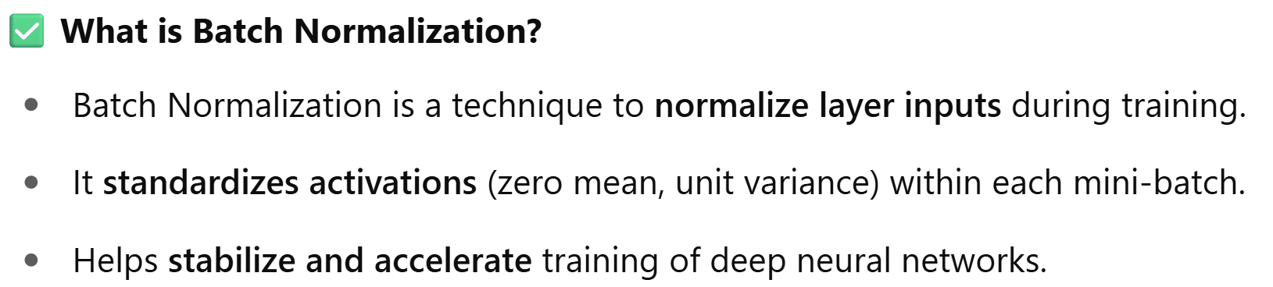
UNIT-5 Batch Normalization

Slide 51
UNIT-5 Batch Normalization
How Batch Normalization works?
During each training iteration (epoch), BN takes a mini batch of data and normalizes the activations (outputs) of a hidden layer. This normalization transforms the activations to have a mean of 0 and a standard deviation of 1.
While normalization helps with stability, it can also disrupt the network's learned features. To compensate, BN introduces two learnable parameters: gamma and beta. Gamma rescales the normalized activations, and beta shifts them, allowing the network to recover the information present in the original activations.

Slide 52
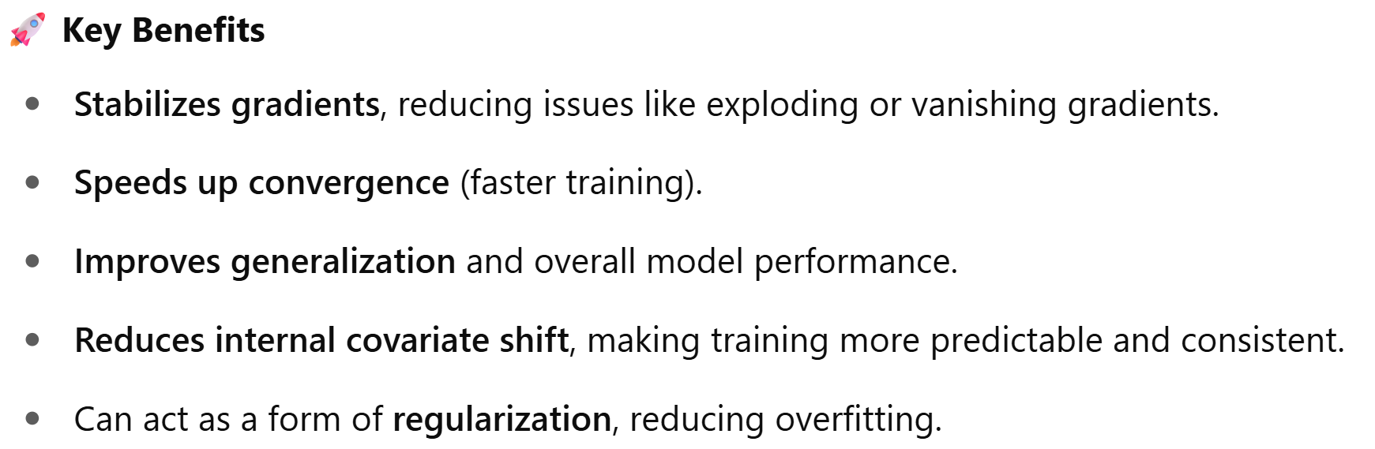

UNIT-5 Batch Normalization

Slide 53
UNIT-5 Batch Normalization
Benefits of Batch Normalization
Faster Convergence: By stabilizing the gradients, BN allows you to use higher learning rates, which can significantly speed up training.
Reduced Internal Covariate Shift: As the network trains, the distribution of activations within a layer can change (internal covariate shift). BN helps mitigate this by normalizing activations before subsequent layers, making the training process less sensitive to these shifts.
Initialization Insensitivity: BN makes the network less reliant on the initial weight values, allowing for more robust training and potentially better performance.

Slide 54

UNIT-5 Regularization - Dropout and Batch normalization

